Slide 1
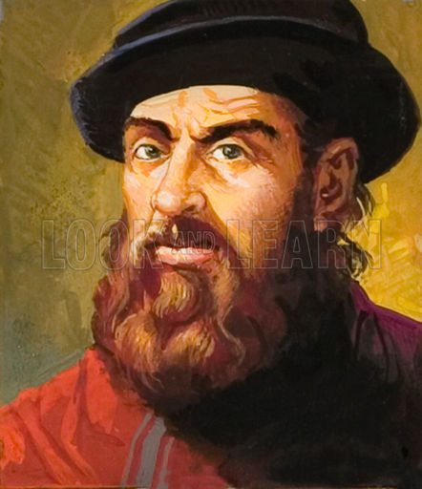
Exploring the World of Network Models
LETS DO THIS!
Content based on: Managing and Troubleshooting Networks, Mike Meyers, Fourth Edition

Slide 2
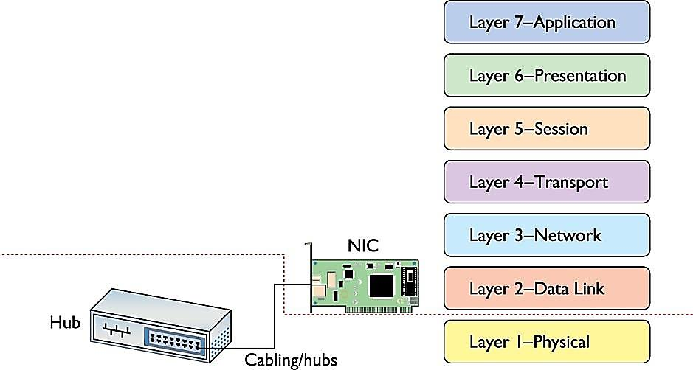
WHERE ARE WE IN OUR JOURNEY
DO YOU UNDERSTAND
LAYERS 1-2?
LET’S REVIEW!

Slide 3
TO INFINITI…AND BEYOND LAYERS 1 & 2!
LAYERS 3-7
Layer 7 - Application
Layer 6 - Presentation
Layer 5 - Session
Layer 4 - Transport
LET’S EXPLORE
Layer 3 - Network
Layer 2 - Data Link
Layer 1 - Physical

Slide 4
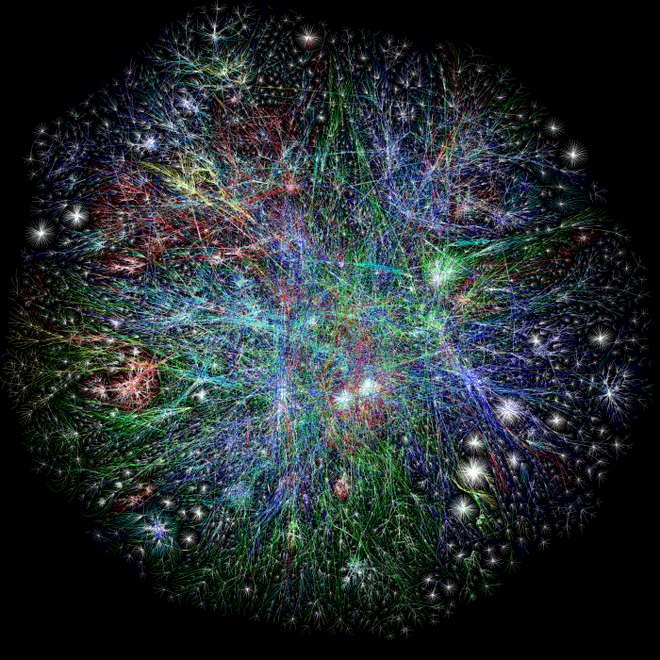
PROBLEMS WITH JUST LAYER 1 & 2
Layers 1 and 2 are good for simple networks
Single switches
But what about for a HUGE network? One like the Internet??
PROBLEMS:
Millions of computers cannot broadcast over huge networks or else data will not get through – TOO MUCH GOING ON!!
Ethernet is not the only data/technology that flows through large networks; don’t know what to do with MAC Addresses
Solution: A logical addressing method not based on the physical machine
The entire Internet

Slide 5
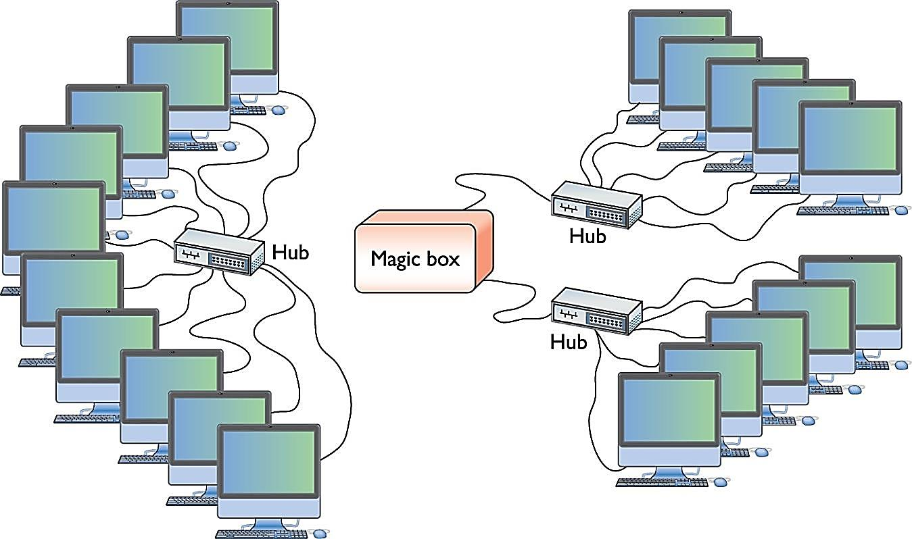
LOGICAL ADDRESSING
Logical Addressing: ignores the hardware and enables breaking a large network into subnets
To move past the physical machine….need to create Network Protocols
Two highly important network protocols that work together to deliver data:
IP (Internet Protocol)
TCP (Transmission Control Protocol)
Most networks today are based on TCP/IP network protocols
What do the protocols do??
LAN broken into two subnets
with five-computers in each
Single Switch;
10-computer LAN

Slide 6
ENTERING THE THIRD LAYER….
Layer 7 - Application
Layer 6 - Presentation
Layer 5 - Session
Layer 4 - Transport
Layer 3 - Network
Layer 2 - Data Link
Layer 1 - Physical

Slide 7
Layer 7 - Application
LAYER 3: THE NETWORK LAYER
INTERNET PROTOCOL (IP)
Layer 6 - Presentation
Layer 5 - Session
Layer 4 - Transport
Layer 3 - Network
What does IP do?
makes sure that a piece of data gets to where it needs to go
Gives each device on a network a unique IP Address (logical address)
Uses a unique dotted decimal notation based on four 8-bit number ranging from 0-255
Example: 192.168.4.232
No two systems on the same network share the same IP address!
By having a IP Addresses (not physical), networks can connect across data lines that don’t use Ethernet (such as phone lines)
What makes IP Addressing possible is the router, or magic box
Routers connect each of the subnets (magic box)
Routers use IP Addresses to forward data (not MAC Addresses)
Layer 2 - Data Link
Layer 1 - Physical
Router:
Connects subnets to broader networks

Slide 8
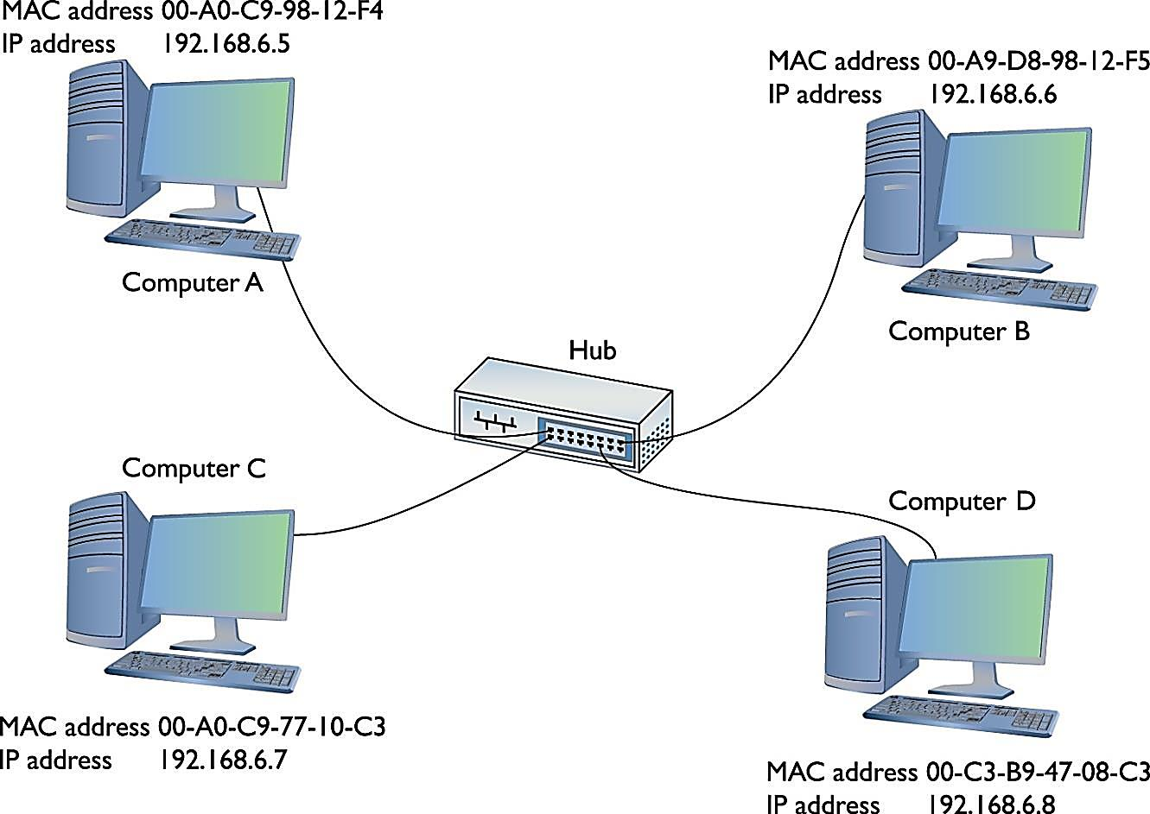
Layer 7 - Application
LAYER 3: THE NETWORK LAYER
INTERNET PROTOCOL (IP) CONT’d
Layer 6 - Presentation
Layer 5 - Session
Layer 4 - Transport
Layer 3 - Network
So…Remember….in a Network powered by TCP/IP…there are two unique identifiers:
MAC Address (burned on NIC; don’t configure; physical address)
IP Address (software; configure; logical address)
Layer 2 - Data Link
Layer 1 - Physical
Each computer has a MAC Address and an IP Address

Slide 9
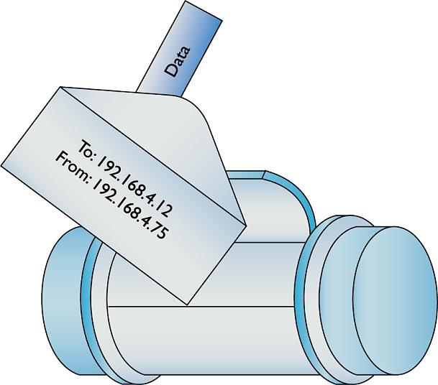
Layer 7 - Application
LAYER 3: THE NETWORK LAYER
PACKETS
Layer 6 - Presentation
Layer 5 - Session
Layer 4 - Transport
Layer 3 - Network
Network Layer contains packets that are created and addressed so they can travel from one network to another
For a TCP/IP Network to send data, there must be a frame and a packet
Frame: enables data to move from one device to another.
INSIDE THE FRAME IS A PACKET
Packet: Inside the frame there is an IP-specific container that enables routers to determine where to send data, regardless of the physical connection type, and the data itself
Each IP packet is handed to the NIC through the operating system.
The NIC encloses the IP packet in a regular frame
So how does this work…
Layer 2 - Data Link
One way to think about a packet
Layer 1 - Physical
Another way to think about a packet
Data within packet
Packet
Frame

Slide 10
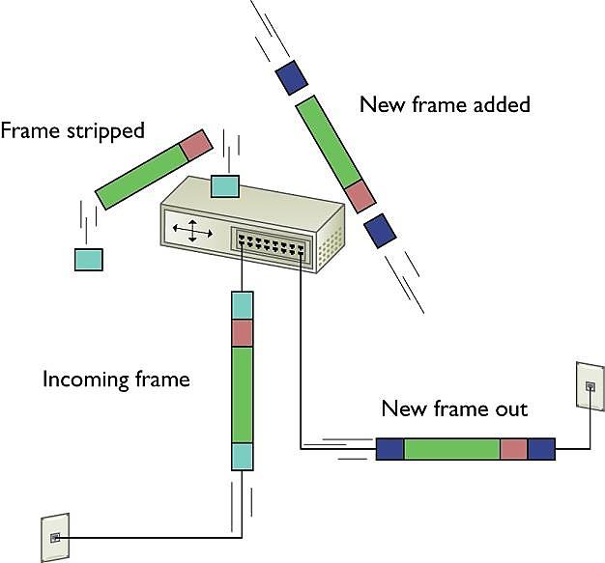
Layer 7 - Application
LAYER 3: THE NETWORK LAYER
HOW DOES THIS WORK SO FAR
Layer 6 - Presentation
Layer 5 - Session
Layer 4 - Transport
Layer 3 - Network
When you send data on the Internet to another computer, which is a TCP/IP network, data goes through many routers before it reaches its destination. Here’s what happens:
Along it’s journey, each router receives frame and:
strips off the frame
determines where to send the data based on the IP Address in the packet
Creates a new frame
Sends new frame with packet enclosed along its way
New frame will be correct frame for appropriate technology (DSL, phone line, for example)
When frame and packet finally reach the correct destination subnet’s router, the router:
strips off the frame
Looks @ the destination IP Address
Create a frame with appropriate destination MAC Address that matches the IP Address and send it to appropriate computer
The NIC then receives the frame and passes off the packet to packet-specific software that knows what to do with the packet, which handles the rest of the process (layers 4-7)
IMPORTANT!! The NIC can’t handle the packet, only the frame, but needs the MAC Address so it can receive the frame
So…The NIC is still highly important because it is the connection between the hardware and software
Layer 2 - Data Link
Layer 1 - Physical

Slide 11
WHERE ARE WE IN OUR JOURNEY
Layer 7 - Application
Layer 6 - Presentation
WE HAVE COVERED LAYERS 1-3
Layer 5 - Session
Layer 3 is the LAST layer
To deal directly with hardware….
Layer 4 - Transport
Layer 3 - Network
Layer 2 - Data Link
Layer 1 - Physical

Slide 12
NOW…LET’S GO INTO LAYERS 4-7
Layer 7 - Application
Layer 6 - Presentation
Remember…
Layers 4-7 work strictly with:
SOFTWARE
Layer 5 - Session
Layer 4 - Transport
LET’S EXPLORE!
Layer 3 - Network
Layer 2 - Data Link
Layer 1 - Physical

Slide 13
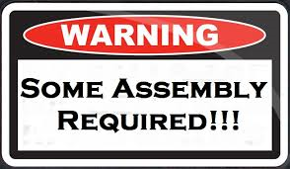
Layer 7 - Application
LAYER 4: THE NETWORK LAYER
ASSEMBLY AND DISASSEMBLY
Layer 6 - Presentation
Layer 5 - Session
Layer 4 - Transport
Layer 3 - Network
Data must be CHOPPED UP before it can be sent across a network
To send data across a huge network, a computer must be able to:
chop the data into chunks that will fit into a packet (and the NIC’s frame)
organize the packets
Hand them to the NIC
To receive data, a computer must be able to:
Recognize a series of incoming packets
Reassemble the packets correctly
Verify that all the packets arrived in solid shape
The Transport Protocol breaks up the data into chunks called segments or datagrams
The Transport Protocol gives each segment of data some type of sequence number (datagrams don’t get sequence numbers)
Embedded into the data within each packet is:
a sequencing number
The total number of segments so the system can put the data back together
In other words…
The TRANSPORT LAYER establishes an order for the data within a packet so that it can be disassembled and reassembled
Layer 2 - Data Link
Layer 1 - Physical

Slide 14
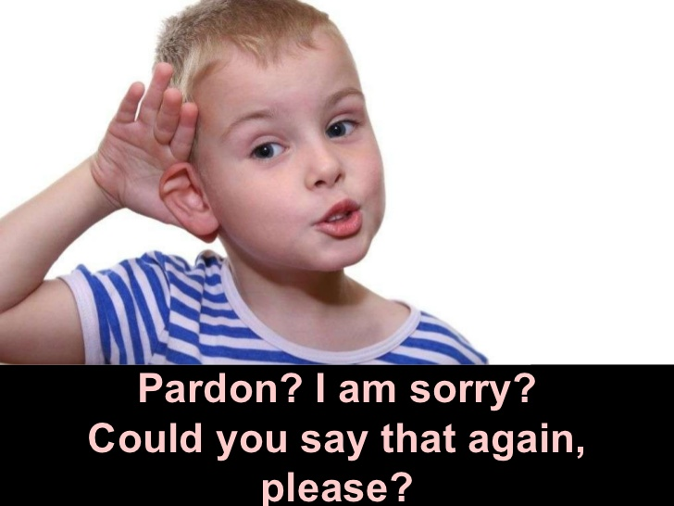
Layer 7 - Application
LAYER 4: THE NETWORK LAYER
REQUESTS UNRECEIVED DATA
Layer 6 - Presentation
Layer 5 - Session
Layer 4 - Transport
Layer 3 - Network
Layer 2 - Data Link
Overall, we talked about how the TRANSPORT LAYER:
Assembles and disassembles data, puts information into the packet
The TRANSPORT LAYER also
Initializes requests to receive packets that weren't received or were corrupted
Basically, the transport layer uses it’s software to ask the sending computer to resend a packet or two that may have been lost or corrupted
Layer 1 - Physical

Slide 15
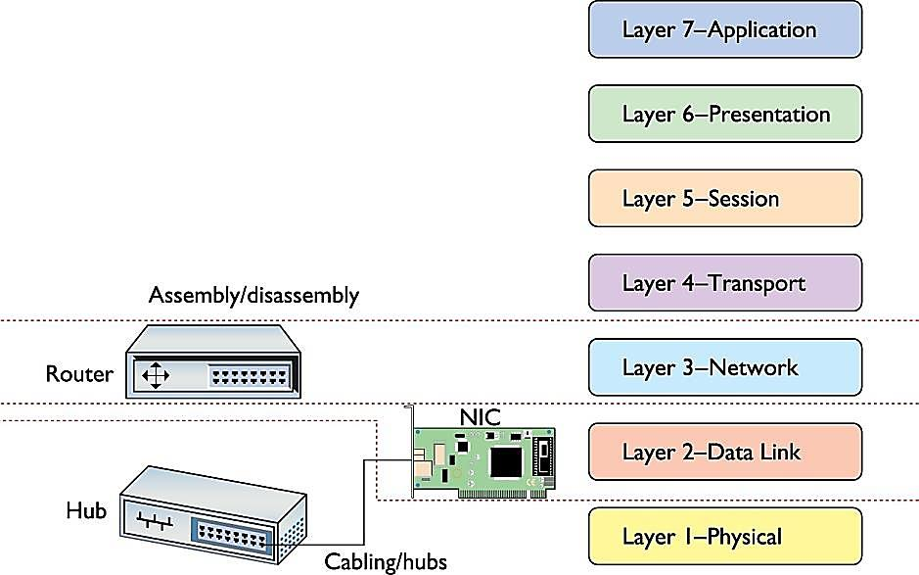
WHERE ARE WE IN OUR JOURNEY
DO YOU UNDERSTAND
LAYERS 1-4?
LET’S REVIEW!

Slide 16
ON TO LAYER 5!
Layer 7 - Application
Layer 6 - Presentation
Layer 5 - Session
Layer 4 - Transport
5 Alive!
Layer 3 - Network
Layer 2 - Data Link
Layer 1 - Physical

Slide 17
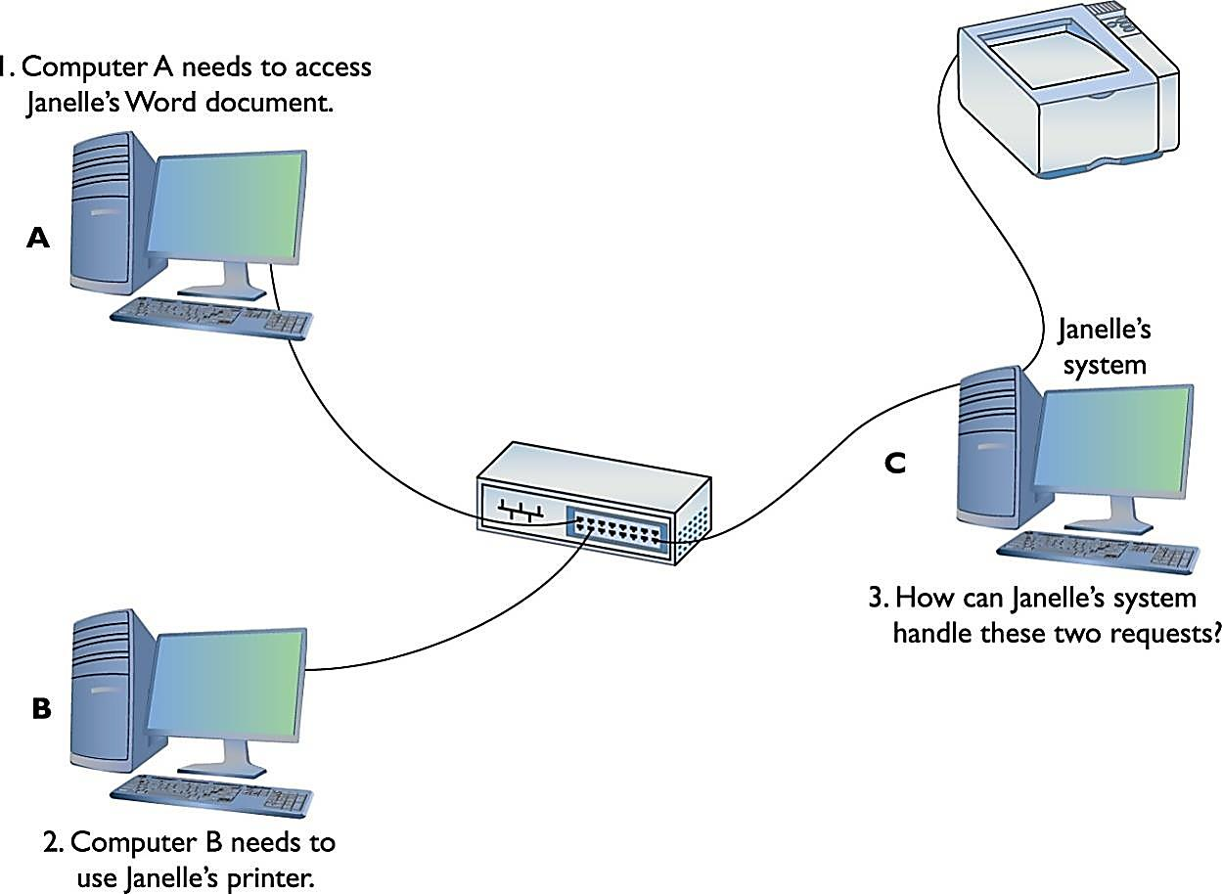
Layer 7 - Application
LAYER 5: THE SESSION LAYER
WHAT IS GOING ON?
Layer 6 - Presentation
Layer 5 - Session
Layer 4 - Transport
Layer 3 - Network
Remember…software assembles and disassembles packets (layer 4), what happens next?
On a network, computers and other systems talk to each other ALL THE TIME (see example)
Such talking occurs through the TCP protocol: enables two hosts to establish a connection and exchange streams of data
In other words, there are requests being sent and received to computers, severs, etc. ALL THE TIME
Print jobs, web addresses, accessing files, etc.
There must be a way to handle the multiple requests:
Must be a way to direct incoming files, print jobs, web pages to the right computer or printer or server, etc.
Operating system must enable one system to be able to connect to another system to verity that the systems can handle the request
Example:
If my computer wants to send a print job to the printer in PH029, my computer contacts the router/switch associated with the printer to see if it can handle the print job
This is accomplished through the SESSION SOFTWARE and is the core of the SESSION LAYER
The SESSION LAYER handles all the sessions for a system. Specifically it:
initiates sessions
accepts sessions
opens and closes sessions
Layer 2 - Data Link
Layer 1 - Physical

Slide 18
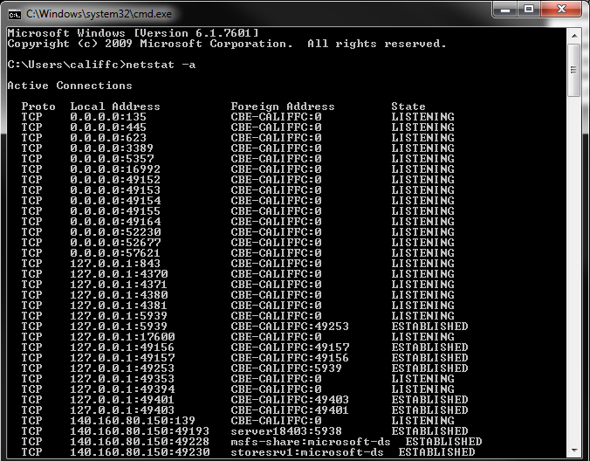
Layer 7 - Application
LETS SEE OUR SESSIONS
Layer 6 - Presentation
Layer 5 - Session
Layer 4 - Transport
Layer 3 - Network
Layer 2 - Data Link
Click Start
Type cmd
Select the cmd application
Type netstat -a
Push enter
Look at all the sessions!
Layer 1 - Physical

Slide 19
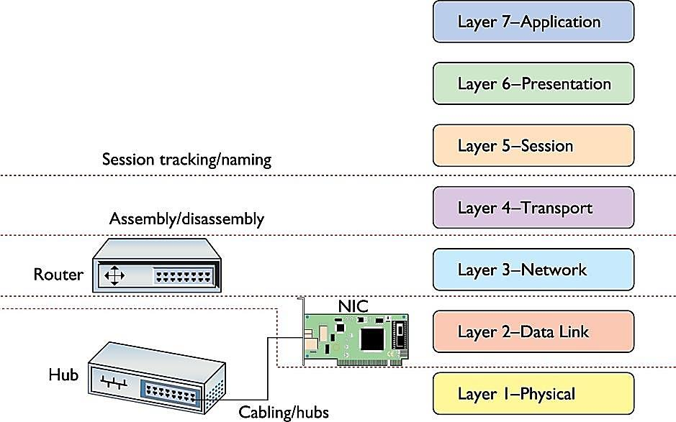
WHERE ARE WE IN OUR JOURNEY
DO YOU UNDERSTAND
LAYERS 1-5?
LET’S REVIEW!

Slide 20
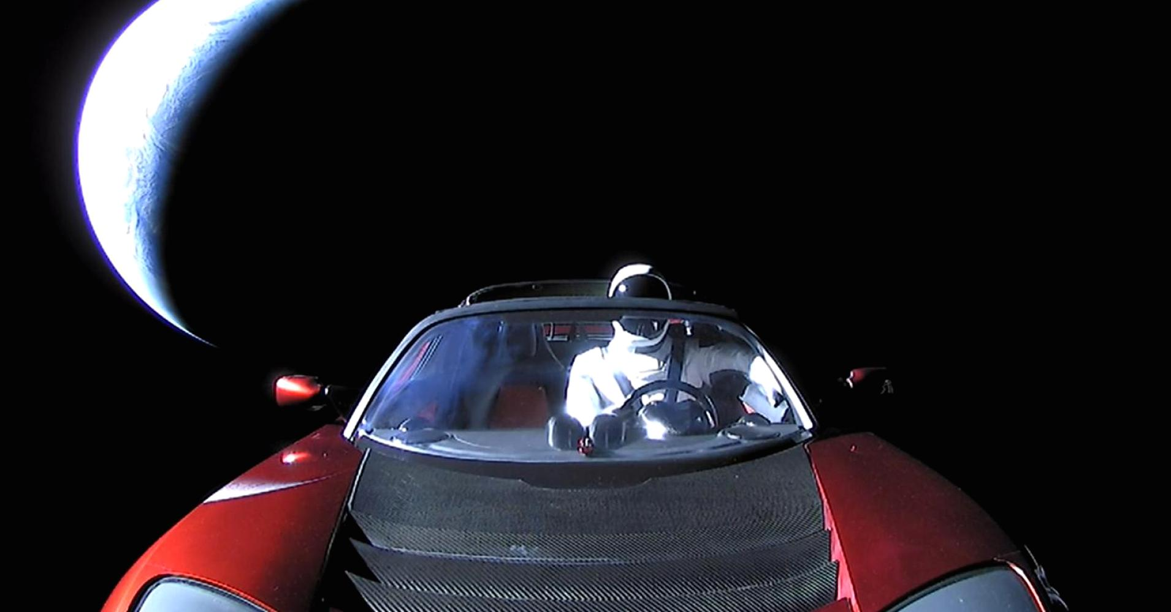
ON TO LAYER 6 & 7!
Layer 7 - Application
Layer 6 - Presentation
Layer 5 - Session
Layer 4 - Transport
Let’s keep exploring!
Layer 3 - Network
Layer 2 - Data Link
Layer 1 - Physical

Slide 21
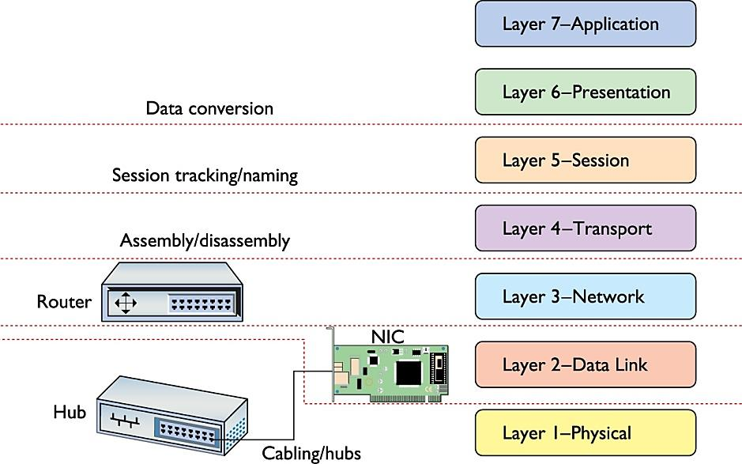
Layer 7 - Application
LAYER 6: THE PRESENTATION LAYER
WHAT IS GOING ON?
Layer 6 - Presentation
Layer 5 - Session
Layer 4 - Transport
Layer 3 - Network
The PRESENTATION LAYER translates and coverts data from lower layers into a format useable by the application layer and vice versa
It prepares the data
Takes data from the application layer and marks it with formatting code such as .doc, .jpg, .txt, etc.
Also…deals with compression and encapsulation. It compresses (on sending computer) and decompresses (on receiving computer) the data file.
In the OSI Model, the protocols that function at this layer are not so clear cut
For example, TLS (Transport Layer Security) and SSL (Secure Sockets Layer) protocols encrypt and decrypt in layer 6, but initiate in layer 5
That is all I expect you to know for now
Layer 2 - Data Link
Layer 1 - Physical

Slide 22
Layer 7 - Application
LAYER 7: THE APPLICATION LAYER
WHAT IS GOING ON?
Layer 6 - Presentation
Layer 5 - Session
Layer 4 - Transport
Layer 3 - Network
The APPLICATION LAYER involves the actual applications you and I use everyday
Windows 7; Google Chrome
You use and experience a network through an application
IMPORTANT: the APPLICATION LAYER does not refer to the applications themselves, but to the code built into all operating systems that enables network-aware applications
In other words, Layer 7 involves more the application programming interfaces (APIs), which enable programmers to make software applications network-aware
Layer 2 - Data Link
Layer 1 - Physical

Slide 23
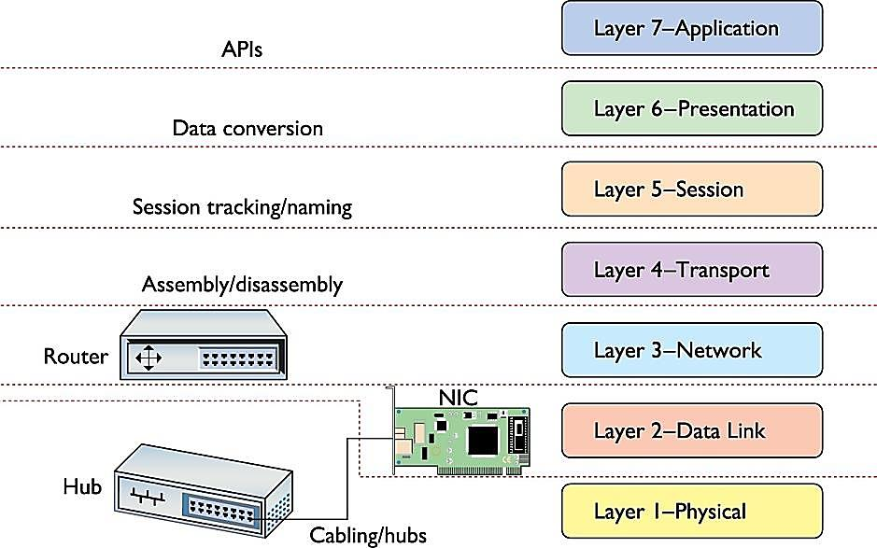
OUR JOURNEY CONCLUDES
That was an epic adventure through
the 7 layers of the OSI Model!!

Slide 24
Let’s Work on HoA#1: Part 2

