Slide 1
Exploring the World of Network Models
LETS DO THIS!
Content based on: Managing and Troubleshooting Networks, Mike Meyers, Fourth Edition

Slide 2
GOALS FOR FIRST WEEK:
Describe how models such as the OSI seven-layer model and the TCP/IP model help technicians understand and troubleshoot networks
Explain the major functions of network hardware with the OSI seven-layer model
Describe the major functions of networks with the TCP/IP model

Slide 3
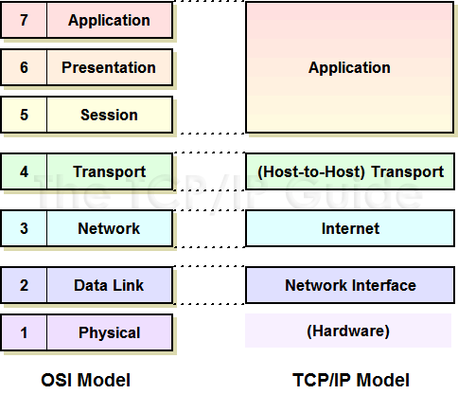
NETWORK MODELS – WHY AND WHAT?:
Why use a model to describe how a network works?
Networking is complicated!!
Communicate with others about what is happening and where it is happening
Two well accepted Network Models:
The Open Systems Interconnect (OSI) model
The Transmission Control Protocol/Internet Protocol (TCP/IP) model
Overall, these models provide:
A powerful tool for diagnosing problems
A common language to describe networks

Slide 4
LAYERS AND PROTOCOLS
Each model is made up of several layers
There are specific protocols (rules, regulations, standards) for each layer
THE OSI model is the most widely used because its very specific about the layers and their functions
Let’s break down the layers…..

Slide 5
HARDWARE AND LAYERS 1 & 2
Layer 7 - Application
Layer 6 - Presentation
Layer 5 - Session
LET’S EXPLORE
Layer 4 - Transport
Layer 3 - Network
Layer 2 - Data Link
Layer 1 - Physical

Slide 6
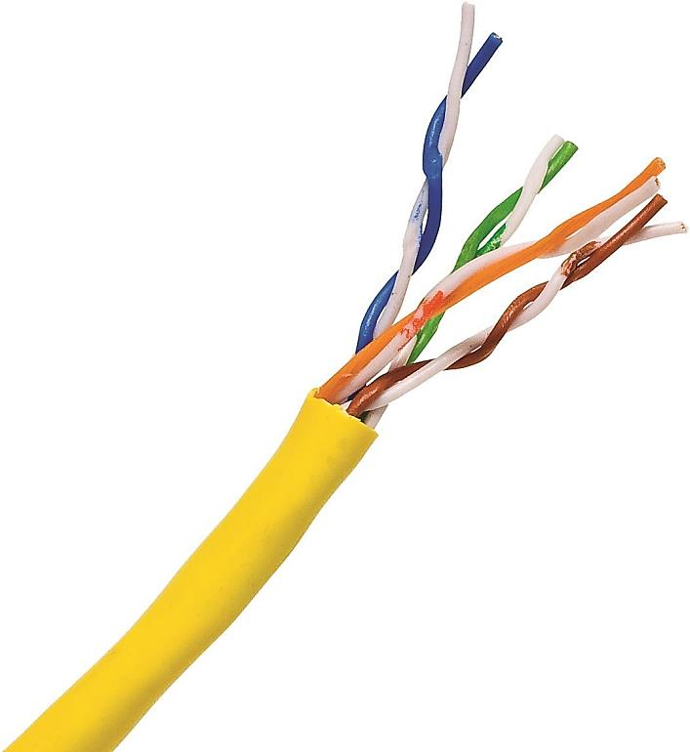
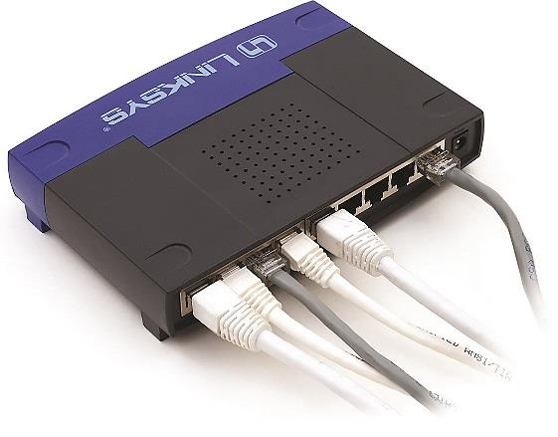
Layer 7 - Application
LAYER 1: PHYSICAL
Layer 6 - Presentation
Layer 5 - Session
The network needs a physical channel through which it can move bits of data between systems
UTP Cables:
Central Box:
The cables lead to a central box
Central box sends the data received from one system to all the other systems attached to it
LAYER 1: defines the method of moving data between computers
Anything that movies data from one system to another is in the OSI Physical Layer
Cables, fiber optics, radio waves
Layer 4 - Transport
Layer 3 - Network
Layer 2 - Data Link
Layer 1 - Physical

Slide 7
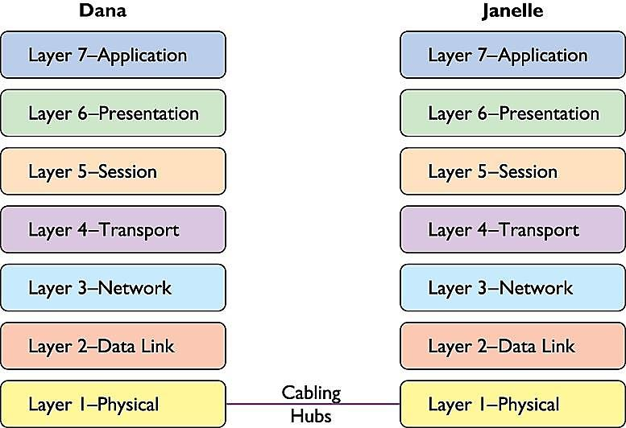
Layer 7 - Application
LAYER 1: EXAMPLE
Layer 6 - Presentation
Layer 5 - Session
Layer 4 - Transport
Layer 3 - Network
Layer 2 - Data Link
Layer 1 - Physical

Slide 8
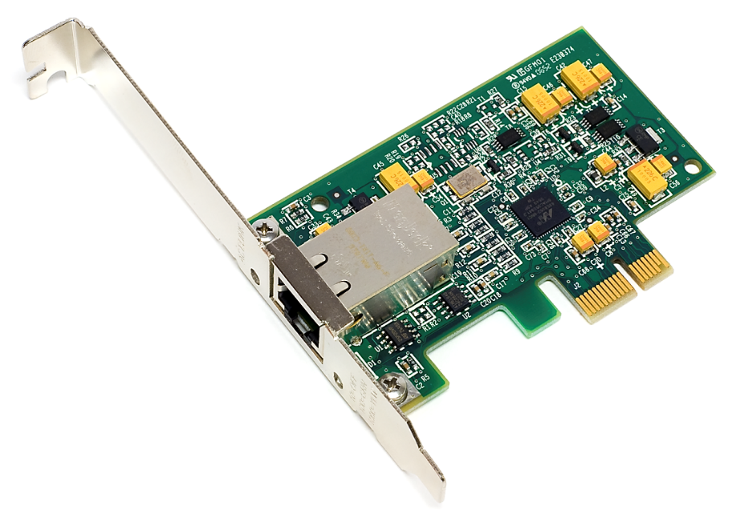
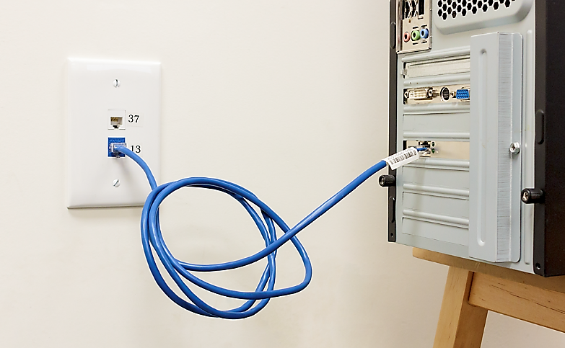
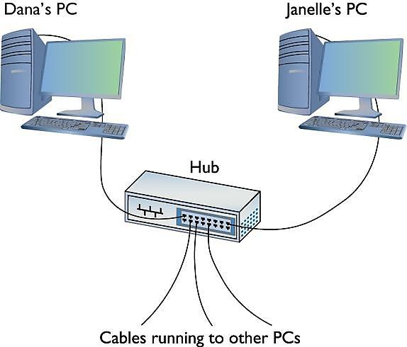
Layer 7 - Application
LAYER 2: DATA LINK
Layer 6 - Presentation
Layer 5 - Session
Network Interface Card (NIC): The interface between the cables and the PCs
Cables run from the NIC in the PC to a jack on the wall or a hub
Inside the wall another cable runs all the way back to the central box
Layer 4 - Transport
Layer 3 - Network
Layer 2 - Data Link
Layer 1 - Physical

Slide 9
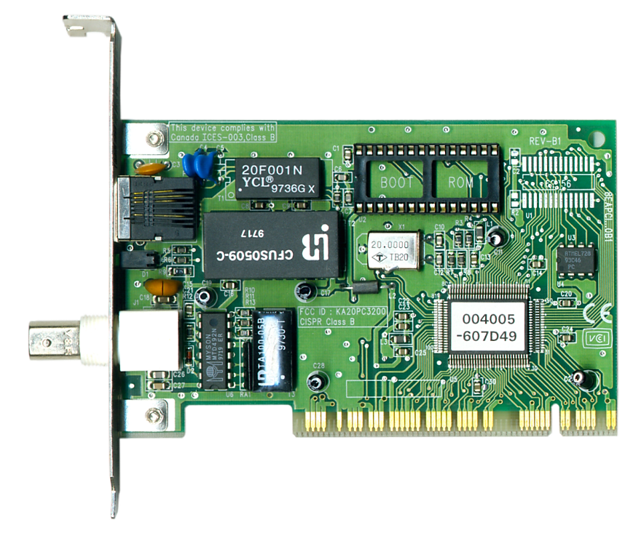
Layer 7 - Application
LAYER 2: DATA LINK
HOW DO NICs WORK?
Layer 6 - Presentation
Layer 5 - Session
Layer 4 - Transport
Layer 3 - Network
Each system (computer, device, etc.) needs a unique identifier
Kind of like an address or telephone number to know where the computer lives
The NIC has a chip that contains a media access control address, or MAC Address
MAC Address is ALWAYS unique
Example:
00-40-05-60-7D-49
00-40-05 represents the NIC Manufacturer
Last six represent the serial number
Layer 2 - Data Link
Layer 1 - Physical
The MAC address is printed on the surface of the chip and burned into the ROM chip:
004005-607D49
In computer terms:
00-40-05-60-7D-49

Slide 10
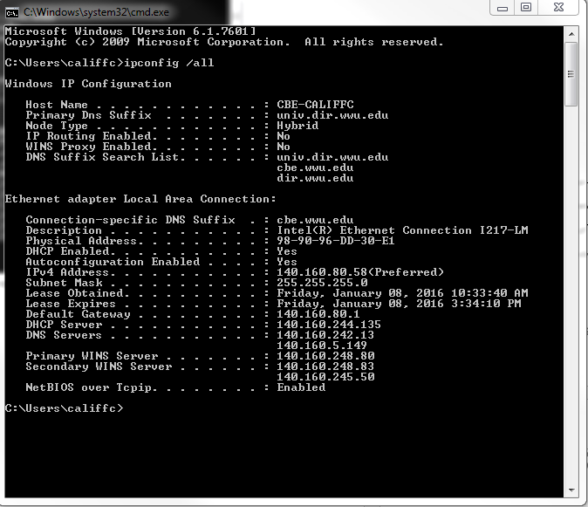
Layer 7 - Application
LETS LOOK UP OUR OWN MAC ADDRESS
Layer 6 - Presentation
Layer 5 - Session
Layer 4 - Transport
Layer 3 - Network
Click Start
Type cmd
Select the cmd application
Type ipconfig /all
Push enter
Your MAC Address is the physical address
Mine is 98-90-96-DD-30-E1
Layer 2 - Data Link
Layer 1 - Physical

Slide 11
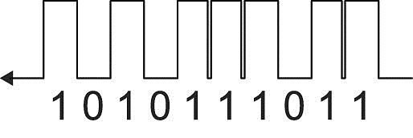
Layer 7 - Application
LAYER 2: DATA LINK
INSIDE THE NIC: HOW ARE MAC Addresses Used?
Layer 6 - Presentation
Layer 5 - Session
Layer 4 - Transport
Layer 3 - Network
Computer data is binary
NICs send and receive binary data as pules of electricity, light, or radio waves
Example:
electric charge (pulse) is a 1 and no pulse is a 0
Flash of light is 1 and no flash is a 0
So…pulses represent binary data 1s and 0s
But how does the network get the right data to the right system?
Frames!
Layer 2 - Data Link
Layer 1 - Physical
1 Pulse
1 Pulse
3
Pulse
2
Pulse

Slide 12
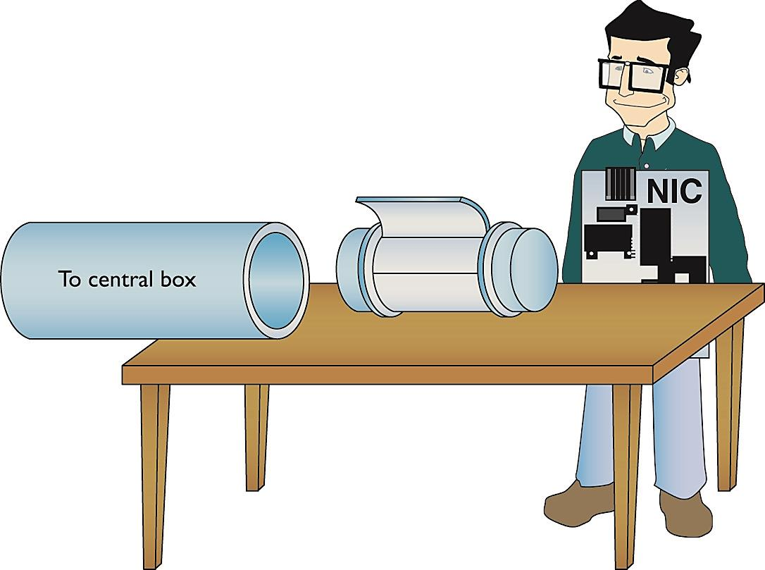
Layer 7 - Application
LAYER 2: DATA LINK
INSIDE THE NIC: FRAMES!
Layer 6 - Presentation
Layer 5 - Session
Layer 4 - Transport
Layer 3 - Network
Networks transmit data by breaking down whatever is moving across the physical layer (files, web pages, print jobs, etc.) into chunks called frames
Frame: a container for a chunk of moving across a network
The NIC creates, sends, and receives this frame
Layer 2 - Data Link
Layer 1 - Physical
Frame
I’m building a frame
Sends to central box (hub, router, etc)

Slide 13
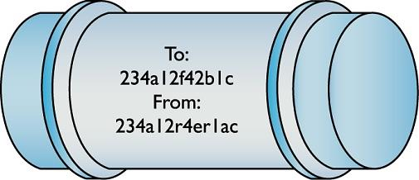
LAYER 2: DATA LINK
INSIDE THE NIC: FRAMES CONT’D!
Layer 7 - Application
Layer 6 - Presentation
Layer 5 - Session
Layer 4 - Transport
A frame is made up of four main parts (see below)
Recipients MAC Address
Sender’s MAC Address
Data: the actual data, etc.
frame check sequence (FCS): checks to see if the frame is structured properly and can be received and sent
Also the Type: specific network technology of the frame (see https://en.wikipedia.org/wiki/Ethernet_frame#Ethernet_frame_types)
Layer 3 - Network
Layer 2 - Data Link
Layer 1 - Physical

Slide 14
Layer 7 - Application
LAYER 2: DATA LINK
HOW DO FRAMES GET TO THE RIGHT SYSTEM?
Layer 6 - Presentation
Layer 5 - Session
Layer 4 - Transport
Layer 3 - Network
When NIC sends frame, it goes into the central box, or hub, or now in present-day called a switch. The switch determines the next steps for the frame
The switch stores information about the MAC addresses in its central database. Using this data, the switch determines whether the recipient MAC Address exists on the network
If the MAC Address exists, the switch forwards the data to the appropriate computer with the correct MAC address
If the MAC Address does not exist, the switch kills the transmission
Note: If the switch does not have the MAC Address on file, it will send a mass broadcast to all computers on the network asking them for their MAC addresses
Layer 2 - Data Link
Layer 1 - Physical

Slide 15
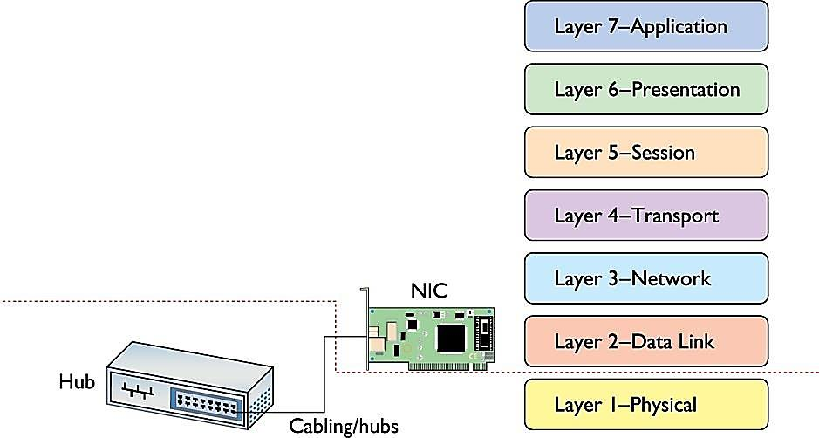
Layer 7 - Application
LAYER 2: DATA LINK
THE COMPLETE FRAME MOVEMENT
Layer 6 - Presentation
Layer 5 - Session
Layer 4 - Transport
The operating system sends data to the NIC
NIC builds a frame to transport the data
NIC puts down the MAC access (recipient and its own) in the frame.
Waits for the cable path to be clear
Sends the frame through the cable to the network
Frame goes down the cable as pulses to the hub or switch which creates a copy of the frame and sends the frame to the correct MAC address
If a MAC Address is found, the frame is sent. If not, the frame is erased.
The NIC receives the frame
The FCS verifies that the data is valid. If so, the NIC sends the data to the software (the OS) to be processed.
Layer 3 - Network
Layer 2 - Data Link
Layer 1 - Physical

Slide 16
Let’s Start on HoA#1, which is adapted from the study guide for the CompTIA Network+ Exam

